Slide 1
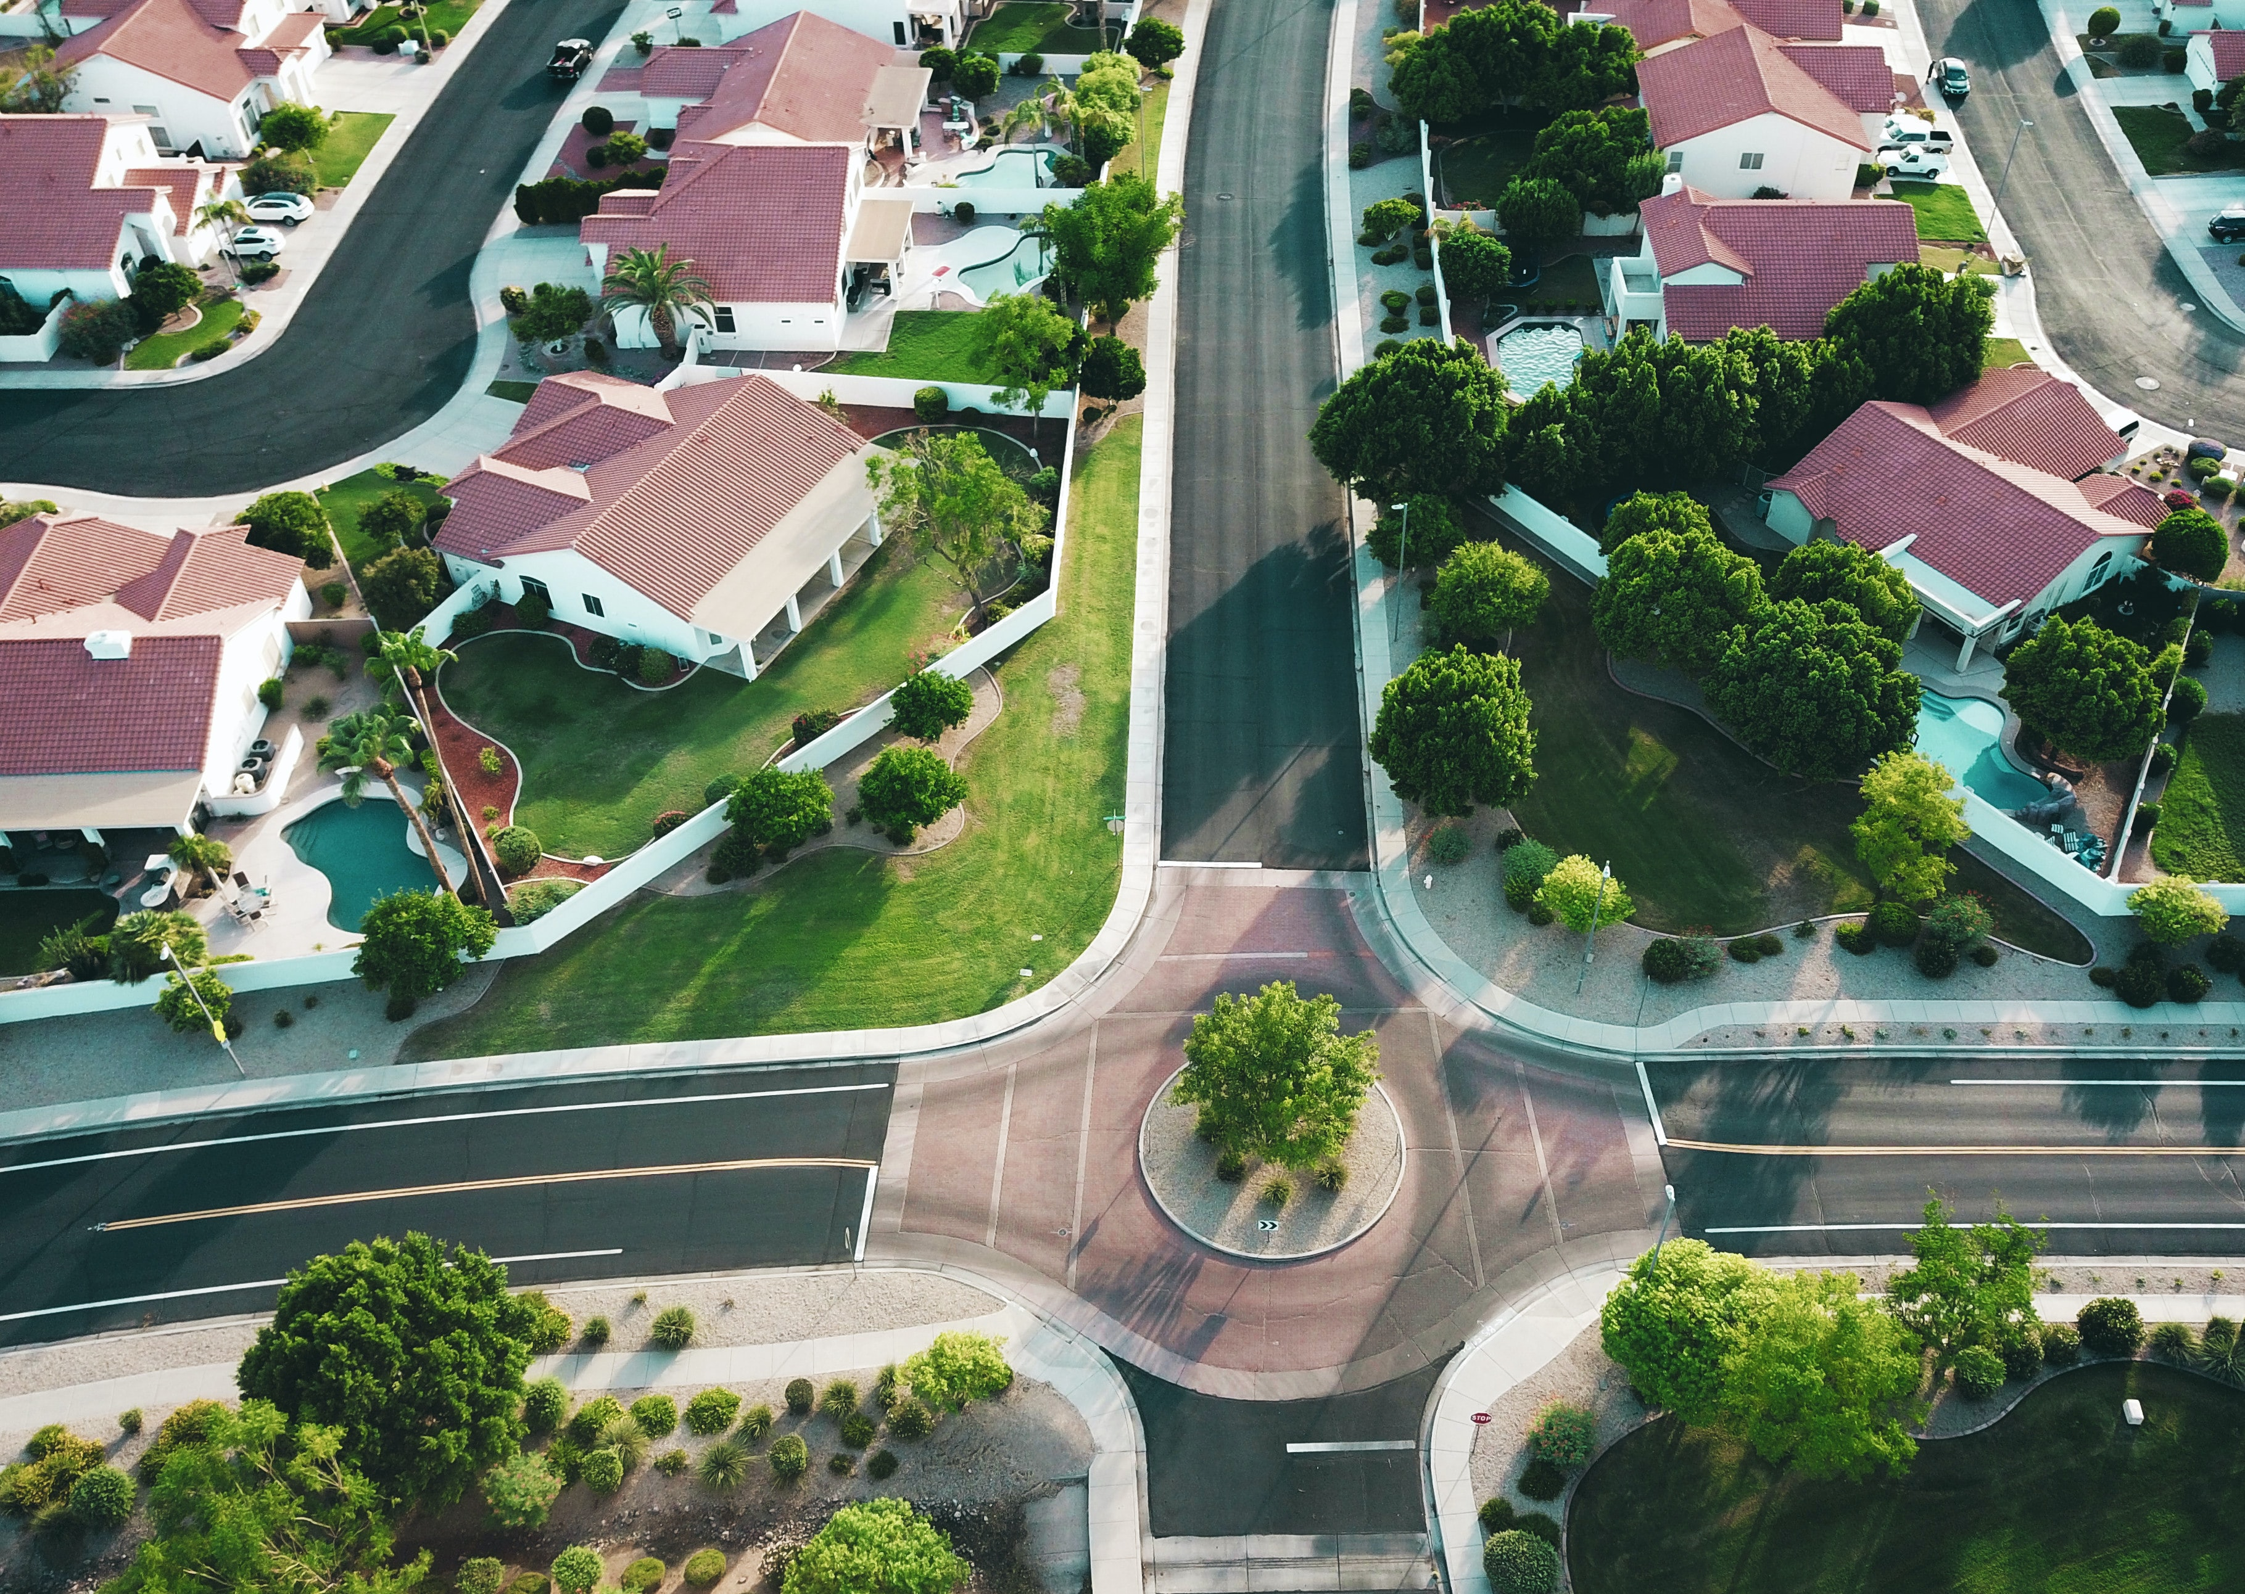
Real Estate Analysis
Joshua Edelstein

Slide 2

Agenda
1. Address Stakeholder
2. Data Background
3. Predictive Model
4. Conclusion/ Recommendations
5. Next Steps

Slide 3
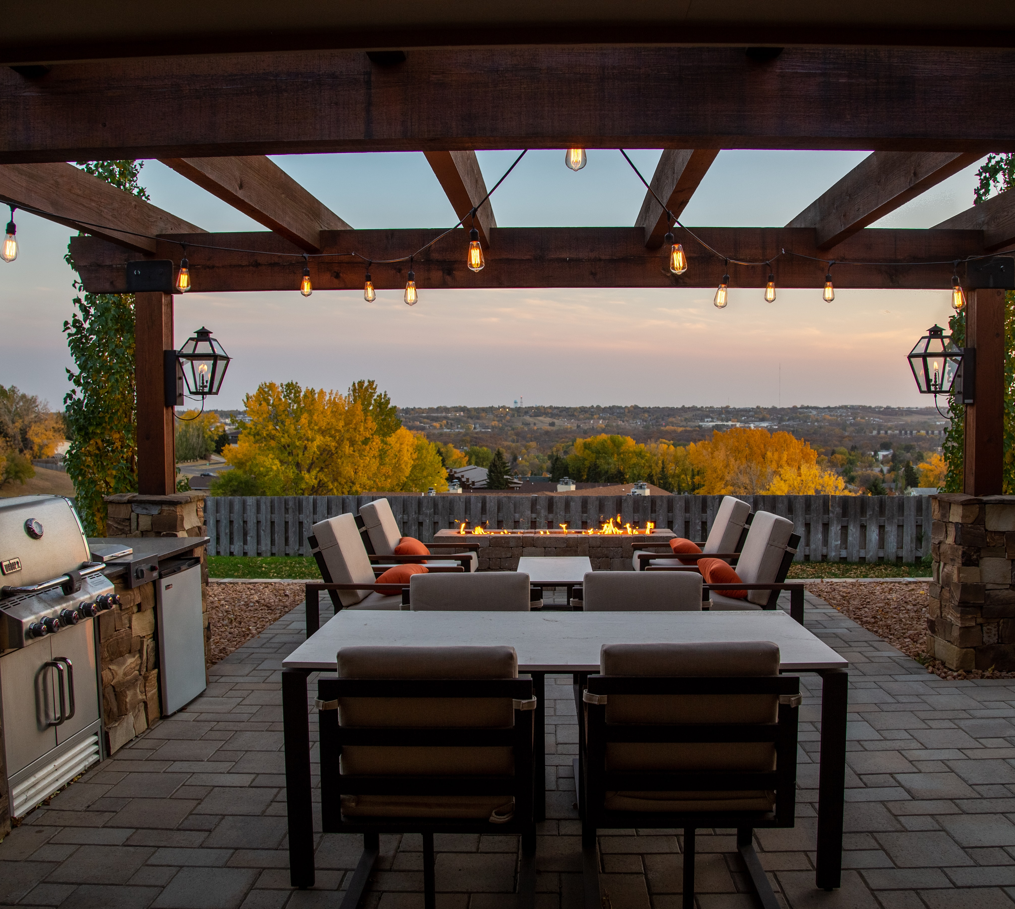
Business Question
King of the Deck Co.
Should they expand into home renovations?
What is the ideal deck size?
Notes:
Clients interested in renovate to sell
Indoor or outdoor space more profitable?
Photo by Arcwind on Unsplash

Slide 4
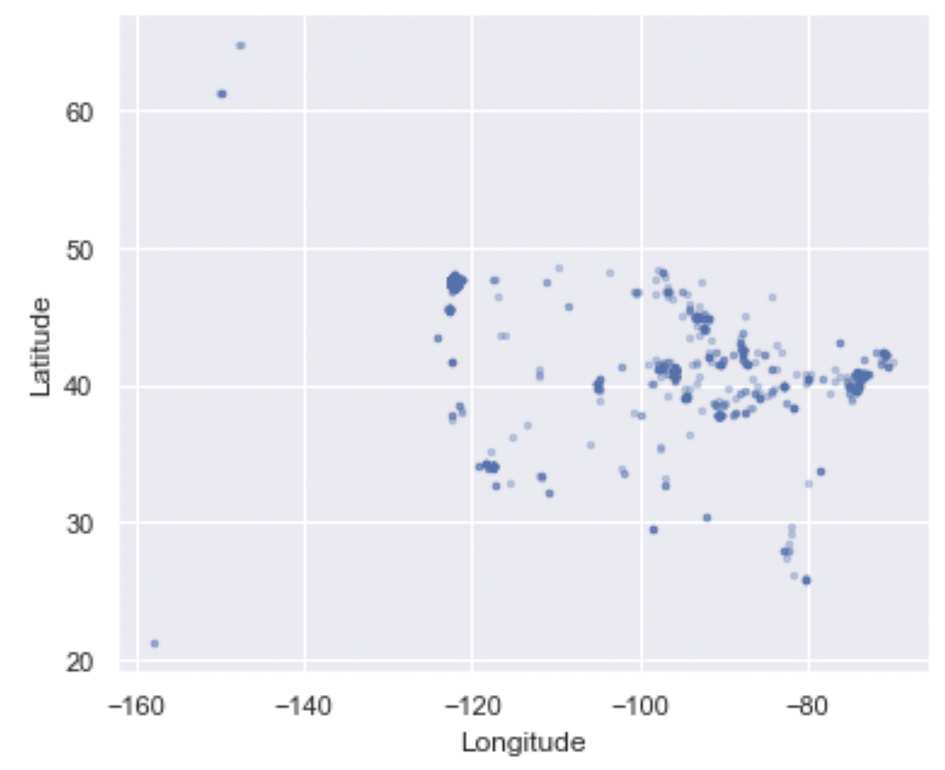
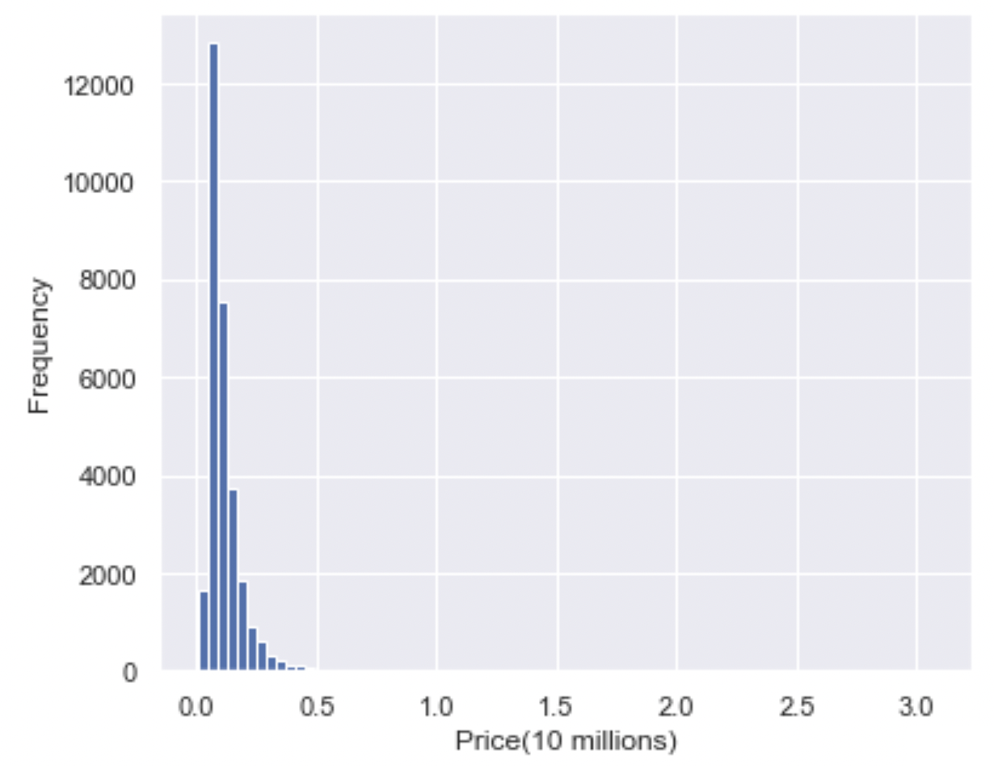
Data Understanding
Over 30,000 within USA
Sold in 2021-2022
Built 1900-2022
Median: 860k
Notes:
King county dataset
Photo by Tom Rumble on Unsplash

Slide 5
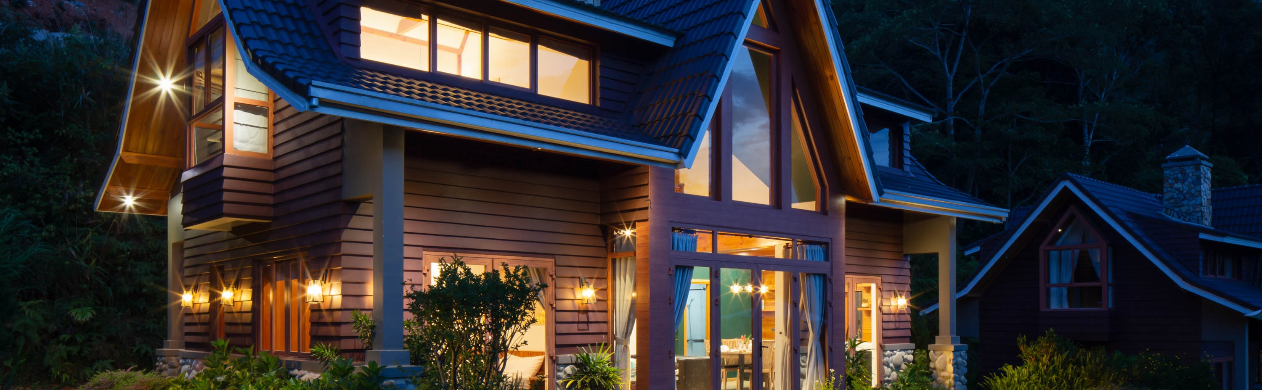
Data Understanding
Data Information
Numeric (Square Footage, bedrooms, bathrooms, etc.)
Categorical (View, Condition, Noise, etc.)
Notes:
Photo by vu anh on Unsplash

Slide 6

Modeling
Notes:
Regression model benefit:
individual factors affect price,
By how much
can control for different factors

Slide 7
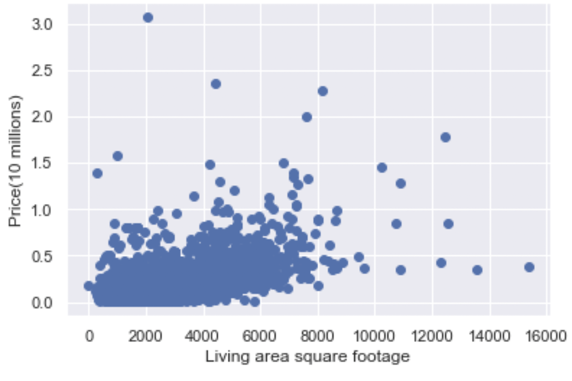
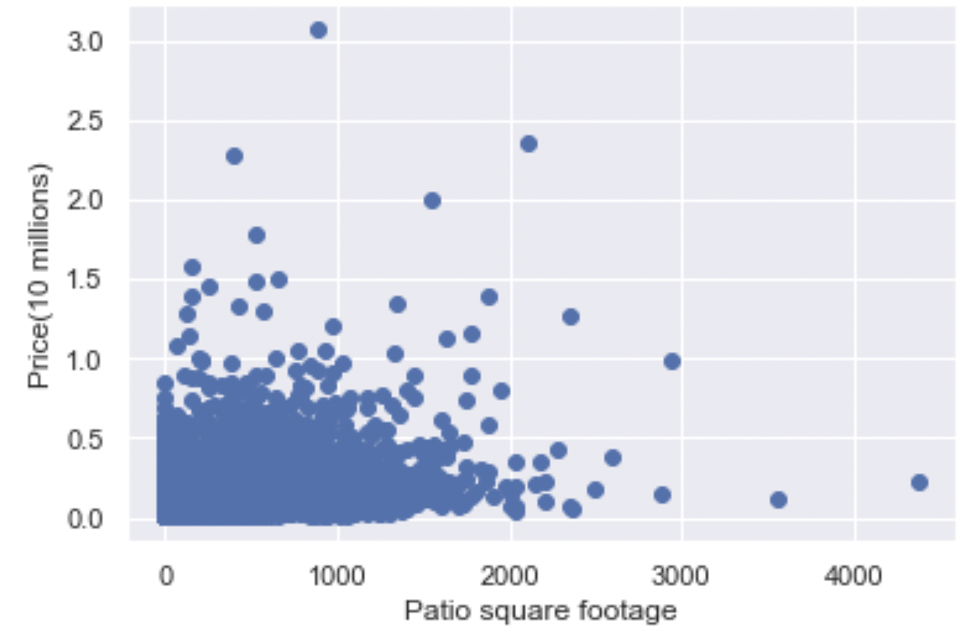
Main Factors:

Slide 8
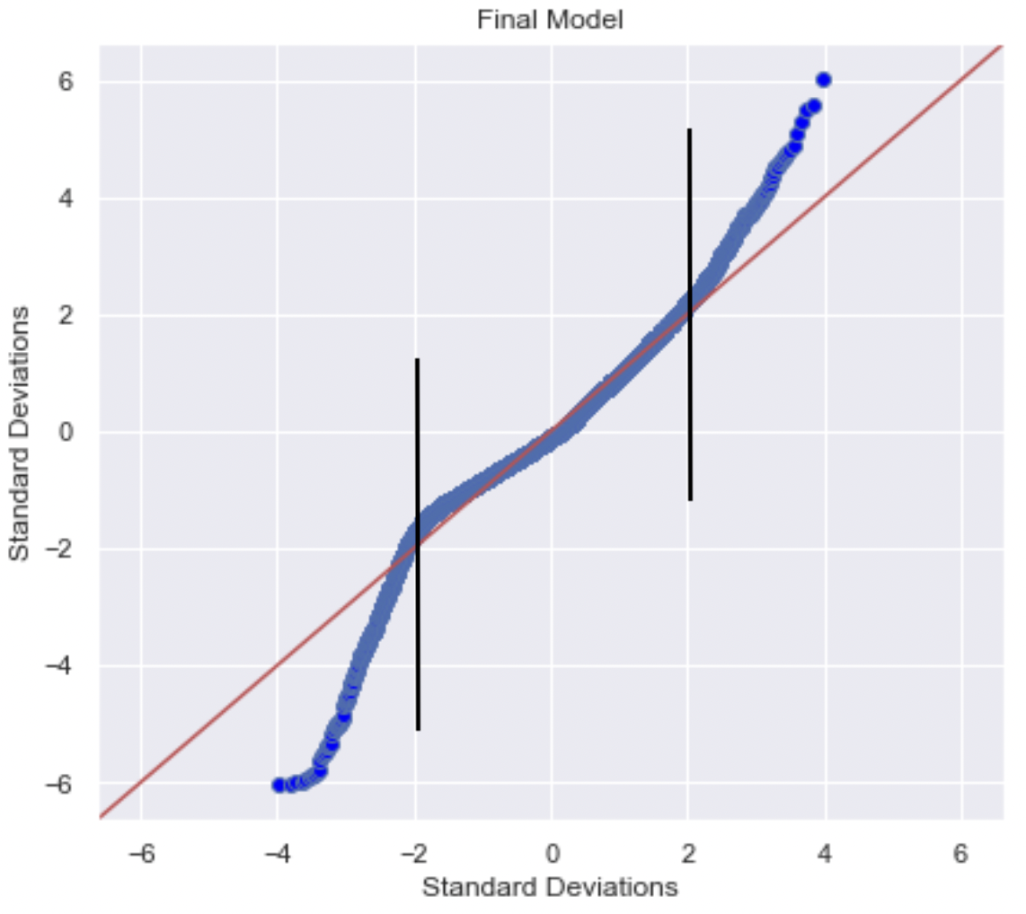
Modeling
The model explains 68% of the variance
Average predictions off by 22%
Accurate within 2 standard deviations
Middle 95% of the data
High and Low Priced Houses
Notes:
Aka effectiveness at predicting
Off by arnd 250k
MAE over RMSE bc we didn’t want model so sensitive to outliers

Slide 9


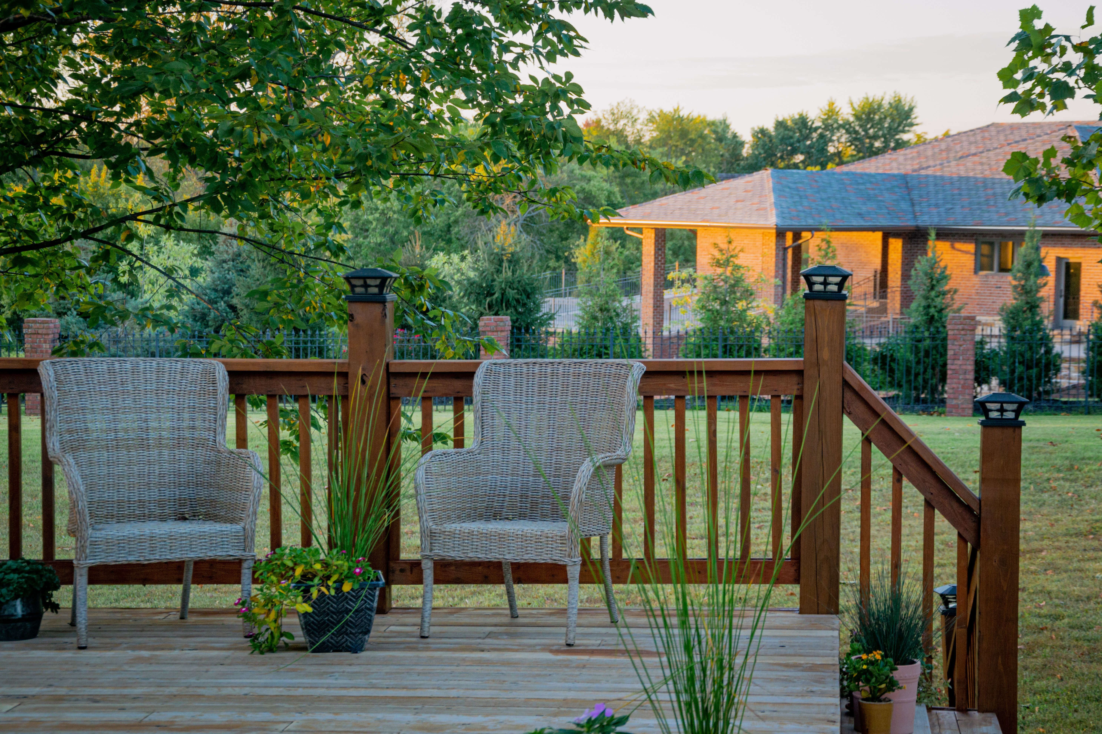
Regression Results
Adding 1 square foot of patio → .006% gain in house price
Adding 1 square foot of living area → .03% gain in house price
Notes:
Living- ~390
Patio - ~90
Photo by Minh Pham on Unsplash
Photo by Ralph (Ravi) Kayden on Unsplash

Slide 10
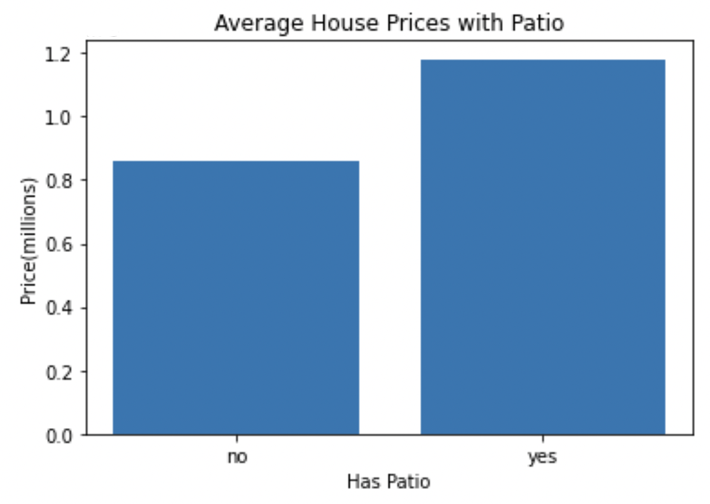
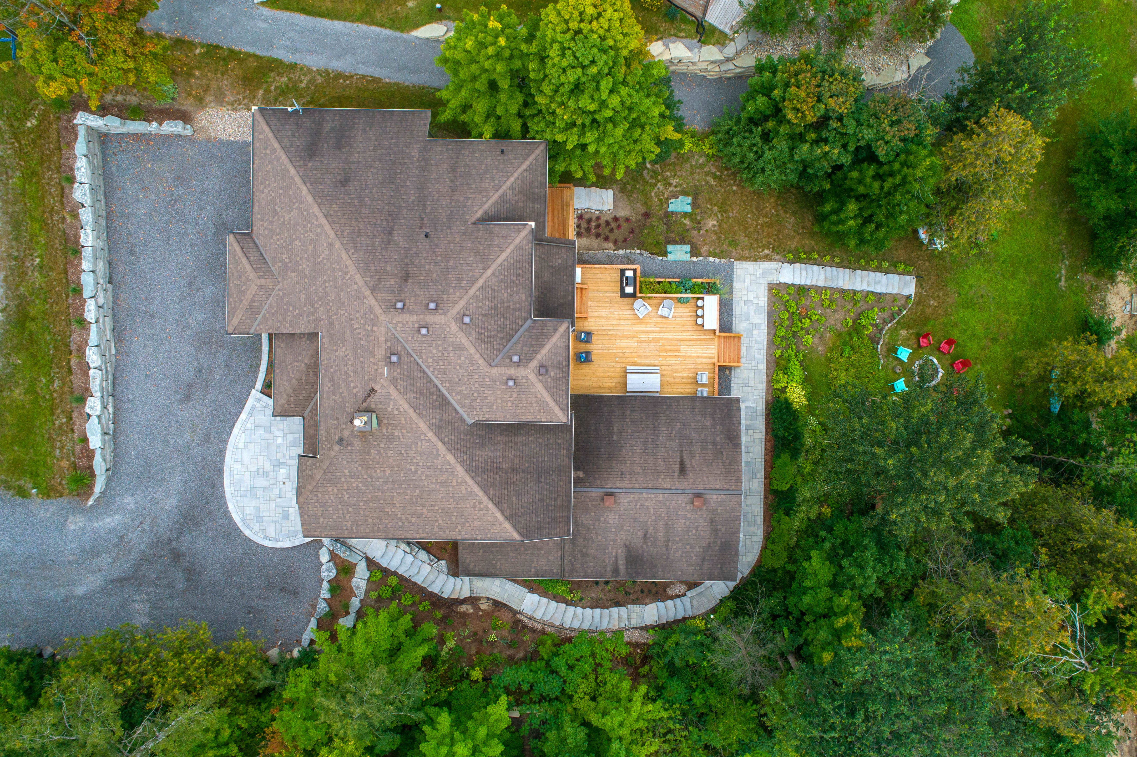
Deck Statistics
Patio adds value to House
Patio vs Living Area
~10%
Patio vs Lot Size
~3%
Notes:
5-20%
1-5%
Photo by Point3D Commercial Imaging Ltd. on Unsplash

Slide 11

Recommendations
Consider Expanding
Benefits of Deck to clients:
Lower Cost
Ideal Deck Size
10% of Living Area
3% of Lot Size
Include Indoor Renovations
Less Headache than full renovation

Slide 12
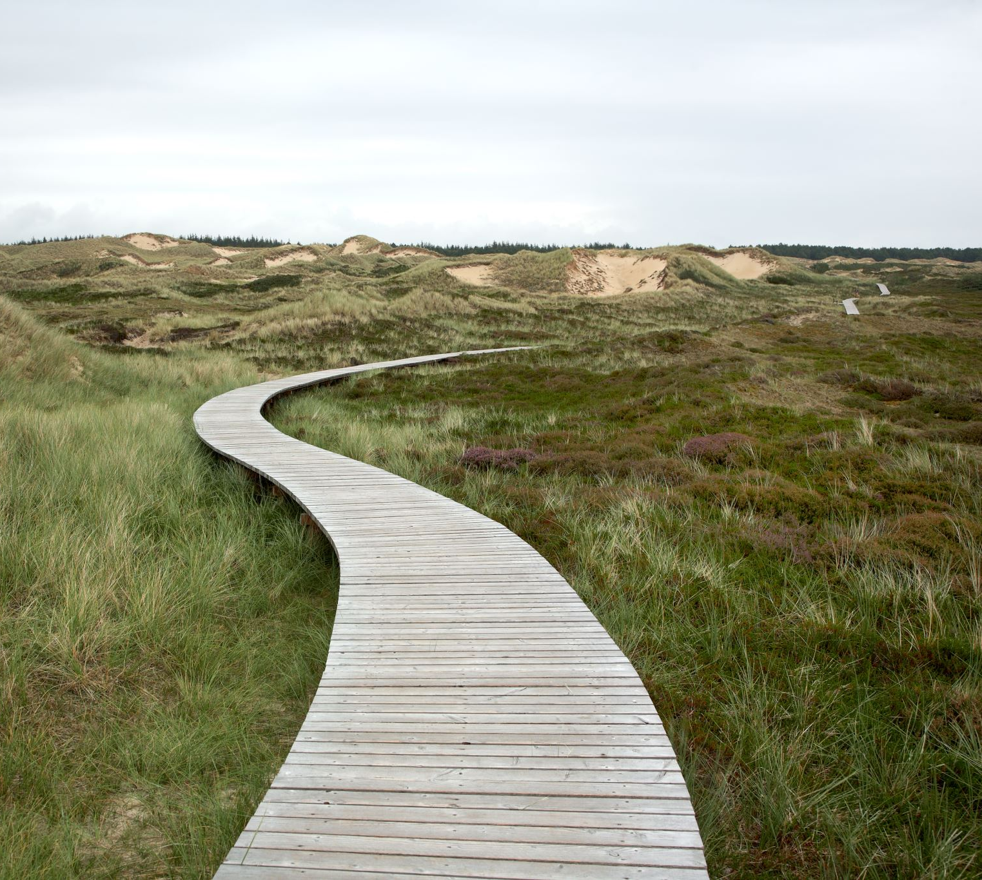
Next Steps
Option I
Look into deck materials
Profitability
Add value
Aesthetically pleasing

Slide 13
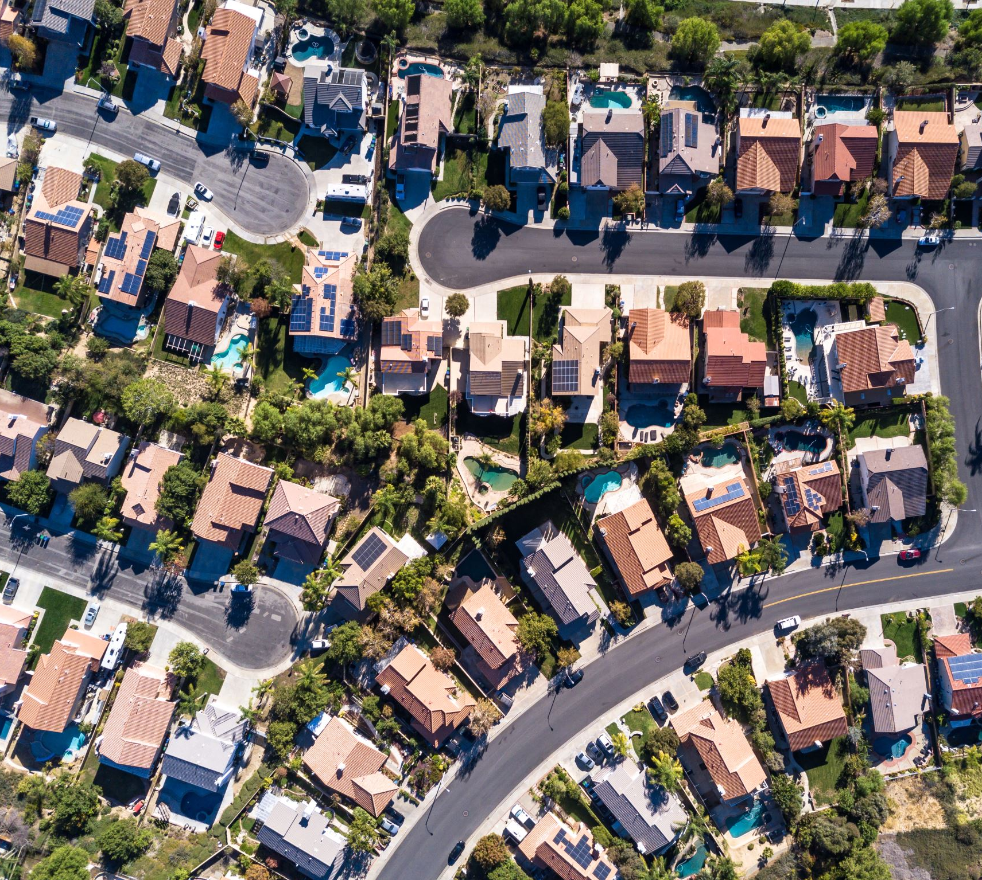
Next Steps(II)
Option II
Create more accurate model with more Data:
House of worship
Proximity to parks
Landscaping (pool, courts, green area)
Social and Economic Factors

Slide 14
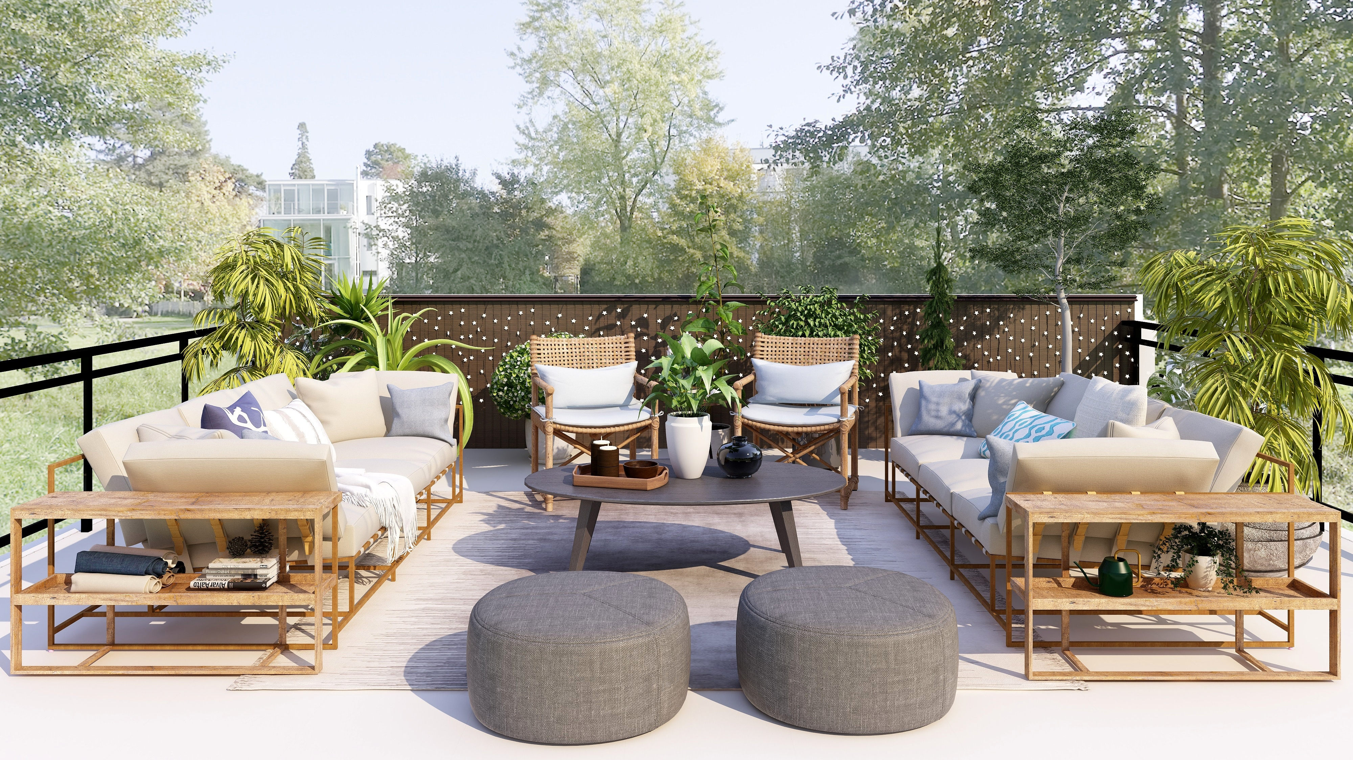
Thank You
Joshua Edelstein
Email: joshuaedelstein15@gmail.com
Notes:
Photo by Collov Home Design on Unsplash

